Slide 1
Updated treatment principles of post-acute Covid-19 myocarditis
Alexey S. Lishuta
MD, PhD, Professor
Sechenov University
Notes:
Dear members of the presidium, organizers and participants, thank you for the opportunity to take part in this conferenceIn this report, we will discuss about post-acute Covid-19 myocarditis
Дорогие члены президиума, организаторы и участники благодарю Вас за возможность принять участие в этой конференции
В данном докладе мы обсудим о post-acute Covid-19 myocarditis

Slide 2
INFORMATION ON A POTENTIAL CONFLICT OF INTEREST
The author declares no potential conflict of interest in the preparation of this report
Notes:
I declare no potential conflict of interest in the preparation of this report
Автор заявляет об отсутствии потенциального конфликта интересов при подготовке данного доклада

Slide 3
Why do we return to the problem of COVID-19?
Coronavirus Cases:
653,374,616
Deaths:
6,657,880
Russia
Coronavirus Cases:
21,658,056
Deaths:
392,560
Azerbaijan
Coronavirus Cases:
824,802
Deaths:
9,986
https://www.worldometers.info
Notes:
Why do we return to the problem of COVID-19? Morbidity and mortality from COVID-19 continues to increase in all countries. And this increase in the incidence of COVID-19 does not plan to stop. What are the consequences?
Почему мы вновь возвращаемся к проблеме COVID-19? Заболеваемость и смертность от COVID-19 продолжает увеличиваться во всех странах. Какие последствия есть?

Slide 4
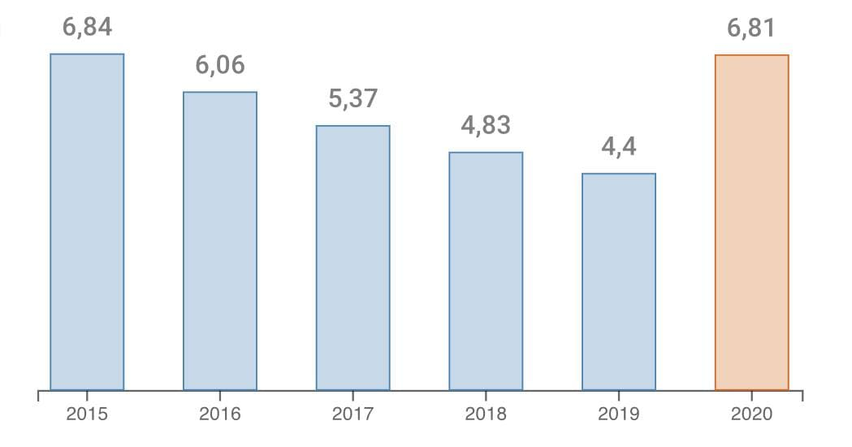
Years of potential life lost
Changes in years of potential life lost
Life expectancy in Russia peaked in 2019 at 73.4 years. However, the coronavirus pandemic has greatly reduced life expectancy. In 2020, it was 71.5 years.
rosmedex.ru
Notes:
For example, in Russia in 2019 life expectancy reached its historical maximum and amounted to 73.4 years. However, the coronavirus pandemic has greatly reduced life expectancy. At the end of 2020, it amounted to 71.5 years due to the increase in years of potential life lost.
Например, в 2019 году ожидаемая продолжительность жизни в России достигла своего исторического максимума и составила 73,4 года. Однако пандемия коронавирусной инфекции сильно сократила ожидаемую продолжительность жизни. По итогам 2020 года она составила 71,5 года из-за увеличения of years of potential life lost.

Slide 5
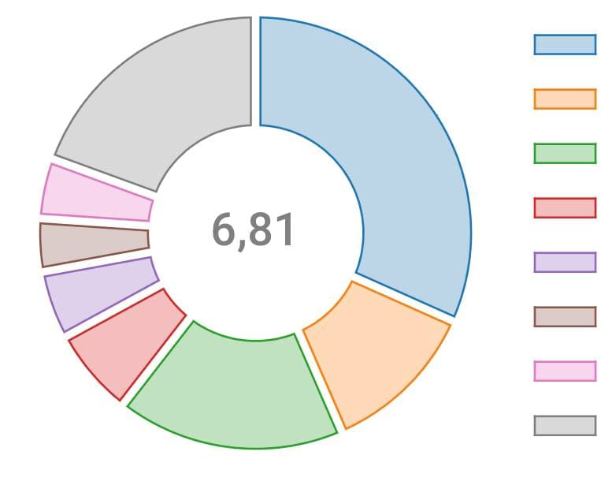
Years of potential life lost
Distribution of Years of potential life lost by cause of death
Cardiovascular
Cancer
External causes
Gastrointestinal
Infections
Respiratory
COVID-19
Others
rosmedex.ru
Notes:
A significant role in the increase in years of potential life lost belongs to cardiovascular diseases. COVID-19 can not only worsen the course of cardiovascular diseases, but also cause prolonged myocarditis.
Существенная роль в увеличении of years of potential life lost принадлежит сердечно-сосудистым заболеваниям. COVID-19 способен не только ухудшать течение сердечно-сосудистых заболеваний, но и вызывать затяжной миокардит.

Slide 6
Myocarditis occurs more frequently among COVID-19 patients
http://dx.doi.org/10.15585/mmwr.mm7035e5
Notes:
Although COVID-19-associated myocarditis is a rare complication, the increase in its prevalence is associated with an increase in the incidence of COVID-19, and patients with COVID-19 have a 16 times greater risk of developing myocarditis.
Хотя миокардит, связанный с COVID-19, является довольно редким осложнением, рост его распространенности связан с ростом заболеваемости COVID-19, а пациенты с COVID-19 имеют в 16 раз больший риск развития миокардита.

Slide 7
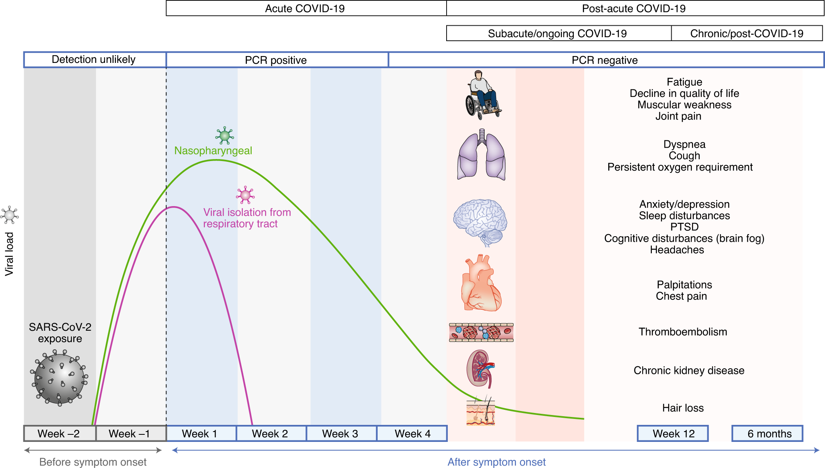
Timeline of post-acute COVID-19
Notes:
Post-acute COVID-19 occurs when characteristic symptoms appear more than 4 weeks after the onset of COVID-19 and is not explained by the presence of other diseases
Постострый COVID-19 имеет место при появлении характерных симптомов более чем через 4 нед после дебюта COVID-19 и не объясняется наличием других заболеваний

Slide 8
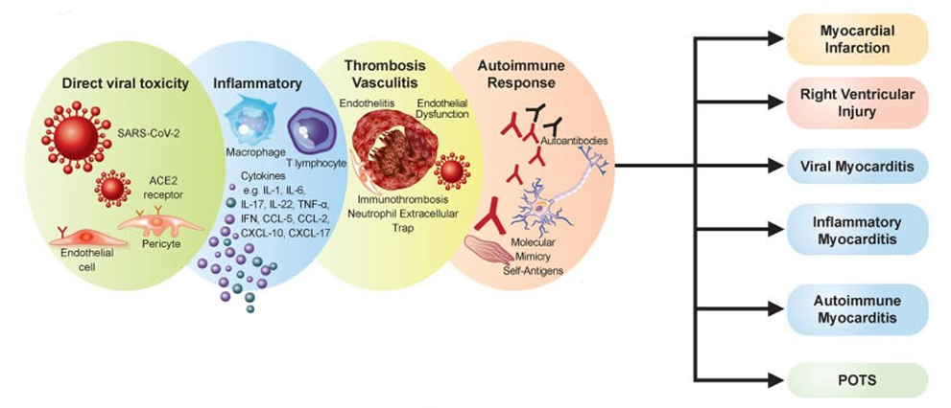
Pathophysiological mechanisms underlying COVID-19-induced myocardial injury
Cardiovascular sequalae
COVID-19 associated myocardial injury:
Acute and chronic pathophysiological mechanisms
https://doi.org/10.1093/eurheartj/ehac031
Notes:
Cardiac involvement in COVID-19 may be associated with various factors that can cause various pathological processes.
Поражение сердца при COVID-19 может быть связано с различными факторами, которые могут вызвать различные патологические процессы

Slide 9
Myocarditis and Other Myocardial Involvement
Myocarditis has been recognized as a rare but serious complication of SARS-CoV-2 infection as well as COVID-19 mRNA vaccination.
Myocardial Involvement – condition deﬁned by abnormal myocardium manifest by electrocardiographic, echocardiographic, CMR and/or histopathologic ﬁndings, with or without symptoms and with or without an elevated cTn.
Myocardial injury – condition deﬁned by a cTn level above the 99th percentile upper reference limit
Notes:
In addition to myocarditis, there are such conditions as Myocardial Involvement (with abnormal myocardium manifest by electrocardiographic, echocardiographic, CMR and/or histopathologic ﬁndings, with or without symptoms and with or without an elevated cTn) and Myocardial injury (condition deﬁned with a cTn level above the 99th percentile upper reference limit)
Кроме миокардита выделяют такие состояния как Myocardial Involvement (состояние, определяемое аномальным миокардом, проявляющееся электрокардиографически, эхокардиографически, МРТ и/или гистологически, с симптомами или без них и с повышенным cTn или без него) и Myocardial injury (состояние, определяемое уровнем cTn выше верхнего референтного предела 99-го процентиля)

Slide 10
Features of the course of COVID-19 in patients with post-acute-COVID-19 myocarditis
Most patients with a negative PCR test at the time of admission
Mild/moderate course of COVID-19 in most patients
Notes:
Features of the COVID-19 course in patients with post-acute COVID-19 myocarditis include:
Often negative PCR test at the time of admission
Mild/moderate course of COVID-19 in most patients

Slide 11
A case of successful treatment post-acute Covid-19 myocarditis
Notes:
As an example of a discussion of the management of a patient with post-acute Covid-19 myocarditis, here is a case of successful treatment of such a patient.
В качестве примера обсуждения ведения пациента с post-acute Covid-19 myocarditis при водим случай успешного лечения такого пациента

Slide 12
Patient K., male, 35 years old
Anamnesis
Nov 2020
Dec 2020
Jan 2021
Feb 2021
Mar 2021
Apr 2021
Notes:
Man, 35 years old
Мужчина, 35 лет

Slide 13
Patient K., male, 35 years old
Anamnesis
21.11.2020 – anosmia
22.11.2020 – subfebrile body temperature
23.11.2020 – acute COVID-19 (SARS-CoV-2 RNA positive), bilateral polysegmental viral pneumonia (CT 2)
24.11.2020-27.11.2020 – body temperature 39-40°C, diarrhea up to 3 times a day
23.11.2020-14.12.2020 – outpatient treatment (enoxaparin sodium 40 mg QD, dexamethasone 8 mg QD, NSAIDs)
Nov 2020
Dec 2020
Jan 2021
Feb 2021
Mar 2021
Apr 2021
Notes:
In January 2020, he happen anosmia, and then subfebrile body temperature. PCR test was positive, and bilateral polysegmental viral pneumonia (CT2) took place in CT scan. Later, the body temperature rose to 39-40C, diarrhea occurred up to 3 times a day.
Outpatient treatment included enoxaparin, dexamethasone and NSAIDs
Он в январе 2020 отметил появление аносмии, а затем субфебрильной температуры тела. ПЦР тест был положительным, при КТ найдена двусторонняя полисегментарная вирусная пневмония (КТ2). Позже температура тела поднялась до 39-40С, имела место диарея до 3 раз в день.
Амбулаторное лечение включало эноксапарин, дексаметазон и НПВС

Slide 14
Patient K., male, 35 years old
(CT 23.11.2020)
(CT 27.11.2020)
Nov 2020
Dec 2020
Jan 2021
Feb 2021
Mar 2021
Apr 2021
Notes:
CT follow-up showed bilateral pneumonia without worsening
Контроль КТ показал двусторонняя пневмония без ухудшения

Slide 15
Patient K., male, 35 years old
Anamnesis
Clinical improvement, normal body temperature, decreased levels of inflammatory markers and D-dimer.
The patient was discharged on 15.12.2020
Nov 2020
Dec 2020
Jan 2021
Feb 2021
Mar 2021
Apr 2021
Notes:
After a few days, there was clinical improvement, normal body temperature, decreased levels of inflammatory markers and D-dimer in laboratory tests. The patient was discharged on December 15
Через несколько дней имело место клиническое улучшение, нормальная температура тела, снижение уровней воспалительных маркеров и Д-димера в лабораторных тестах
Пациент был выписан 15 декабря

Slide 16
Patient K., male, 35 years old
Anamnesis
Clinical worsening (after 20.01.2021): the appearance of dyspnea during physical exertion (walking up to 10 m), orthopnea, dry cough in a horizontal position, swollen ankles, palpitation.
Nov 2020
Dec 2020
Jan 2021
Feb 2021
Mar 2021
Apr 2021
Notes:
However, a month later happen a clinical worsening: there was shortness of breath on exertion, orthopnea, dry cough in a horizontal position, swollen ankles, palpitations
Однако через месяц имело место клиническое ухудшение: случилась одышка при физической нагрузке, ортопное, сухой кашель в горизонтальной позиции, отеки голеней, сердцебиение

Slide 17
Suspicion for myocarditis
When there is increased suspicion for cardiac involvement with COVID-19, initial testing should consist of an ECG, measurement of cTn (preferably using a high-sensitivity assay), and an echocardiogram.
Cardiology consultation is recommended for those with a rising cTn and/or ECG or echocardiographic abnormalities concerning for myocarditis.
CMR is recommended in hemodynamically stable patients with suspected myocarditis.
Notes:
When there is suspicion for cardiac involvement in a post-COVID-19 patient with cardiac symptoms (dyspnea, edema, palpitations) initialy testing should consist of an ECG, measurement of cTn, and an echocardiogram followed by consultation with a cardiologist. If possible, CMR is recommended
Когда есть подозрение для сердечного вовлечения в пациенте после COVID-19 с кардиальными симптомами (одышка, отеки, сердцебиение) testing should consist of an ECG, measurement of cTn, and an echocardiogram с последующей консультацией кардиолога. При возможности рекомендовано выполнение CMR
Having at least two of the three Lake Louise criteria for myocarditis (2018) on contrast-enhanced cardiac magnetic resonance imaging and/or Dallas morphological criteria for myocarditis (ESC 2013)

Slide 18
Patient K., male, 35 years old
21.01.2021
Nov 2020
Dec 2020
Jan 2021
Feb 2021
Mar 2021
Apr 2021
Notes:
Our patient presented with ECG abnormalities: Tachysystolic atrial flutter, low voltage, nonspecific ST-T wave disorders
Наш пациент имел абнормальности ЭКГ:
Тахисистолическая форма трепетания предсердий, низкий вольтаж от конечностей, неспецифические нарушения ST-T

Slide 19
Patient K., male, 35 years old
Apical position | 21.01.2021
Left ventricle, mm | 50×86
Right ventricle, mm | 42×78
Left atrium, mm | 50×62
Right atrium, mm | 50×58
Interventricular septum, mm | 11
Posterior wall of the left ventricle, mm | 11
Wall of the right ventricle, mm | 5
Pulmonary artery systolic pressure, mm Hg | 40
LV EF, % | 27
Fluid in the pleural cavities, layer thickness | right – 90 mm, left – 70 mm
Separation of the pericardium | 4-5 mm
Nov 2020
Dec 2020
Jan 2021
Feb 2021
Mar 2021
Apr 2021
Notes:
Also echo signs as atrial dilatation, decreased left ventricular ejection fraction, and increased pulmonary artery systolic pressure
Эхо показало дилатацию предсердий, снижение фракции выброса левого желудочка и повышение pulmonary artery systolic pressure

Slide 20
Patient K., male, 35 years old
Parameter | 21.01.2021
Thyroid stimulating hormone (ultra), mIU/l | 3.870
Troponin Т, ng/ml | 0.032
NT-proBNP, pg/ml | 3071
C-reactive protein, mg/l | 27
Procalcitonin, ng/ml | 0.045
Nov 2020
Dec 2020
Jan 2021
Feb 2021
Mar 2021
Apr 2021
Notes:
And increases in troponin, NT-probNP as indicators of myocardial injury, and C-reactive protein reflecting systemic inflammation.
Были также повышение уровней тропонина, NT-probNP как показателей поражения миокарда и С-реактивного белка, отражающего системное воспаление

Slide 21
Myocarditis is defined by
1) cardiac symptoms (eg, chest pain, dyspnea, palpitations, syncope);
2) an elevated cTn; and
3) abnormal electrocardiographic, echocardiographic, CMR, and/or histopathologic findings on biopsy or postmortem evaluation in the absence of flow-limiting coronary artery disease
Notes:
When do we think of myocarditis based on initial testing?
If present:
1) cardiac symptoms (eg, chest pain, dyspnea, palpitations, syncope);
2) an elevated cTn; and
3) abnormal electrocardiographic, echocardiographic, CMR, and/or histopathologic findings on biopsy or postmortem evaluation in the absence of flow-limiting coronary artery disease
Когда по результатам инициального тестирования мы думаем о миокардите?
Если имеется:

Slide 22
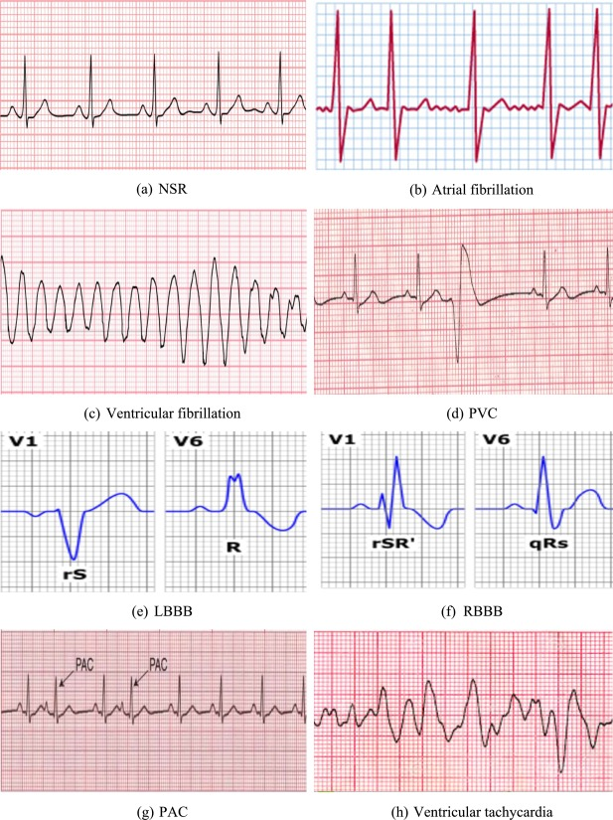
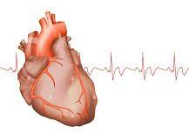
Clinical variants of post-acute-COVID-19 myocarditis
Arrhythmic (atrial fibrillation, supraventricular and / or ventricular extrasystoles)
Decompensated (dilated)
Mixed
Notes:
There are 3 main clinical variants of myocarditis - arrhythmic, decompensated and mixed
The arrhythmic variant is represented by various rhythm and conduction disturbances.
Decompensated or dilated is represented by dilatation of the heart chambers
The mixed variant includes signs of both arrhythmic and dilated variants
Имеется 3 основных клинических варианта миокардита – аритмический, декомпенсированный и смешанный
Аритмический вариант представлен различными нарушениями ритма и проводимости
Декомпенсированный или дилатационный представлен дилатацией камер сердца
Смешанный вариант включает признаки и аритмического и дилатационного вариантов

Slide 23
Risk classification of myocarditis (Mayo Clinic)
Low risk | Intermediate risk | High risk
Chest pain Supraventricular arrhythmias AV blockade Preserved systolic function Rapid response to ongoing therapy (1-4 weeks) | Moderately pronounced structural and functional changes in the myocardium Nonsustained ventricular arrhythmias Late accumulation of gadolinium in the myocardium with no remodeling of the heart chambers Life-threatening arrhythmias and conduction disturbances are registered No syncope | Persistent circulatory decompensation Severe persistent LV dysfunction Life-threatening arrhythmias Persistent AV block with severe LV dysfunction Recurrent syncope
Favorable prognosis | Uncertain prognosis | Poor prognosis
DOI: 10.1016/S0025-6196(11)60670-8
Notes:
There is a simple and convenient classification of myocarditis, based on an assessment of the initial state of patients (Mayo clinic), which allows you to determine the prognosis and choose the tactics of treatment. Distinguish between high-risk, moderate-risk, and low-risk patients based on the main symptoms
Имеется классификация миокардитов, основанная на оценке исходного состояния пациентов (Mayo clinic), позволяющая определить прогноз и выбрать тактику лечения. На основе ведущих симптомов различают пациентов высокого риска, умеренного риска и низкого риска

Slide 24
Patient K., male, 35 years old
Diagnosis:
Post-acute COVID-19 diffuse myocarditis, moderate severity, intermediate risk according to Mayo, mixed clinical variant (arrhythmic, decompensated). Cardiac arrhythmias and conduction disorders: atrial flutter-fibrillation of unknown duration; left anterior bundle branch block, transient sinoatrial block of the II degree.
Nov 2020
Dec 2020
Jan 2021
Feb 2021
Mar 2021
Apr 2021
Notes:
So, our patient was diagnosed with: Post-acute COVID-19 diffuse myocarditis, moderate severity, intermediate risk according to Mayo, mixed clinical variant (arrhythmic, decompensated). Cardiac arrhythmias and conduction disorders: atrial flutter-fibrillation of unknown duration; left anterior branch block, transient sinoatrial blockade of the II degree.
Таким образом наш пациент имел диагноз:

Slide 25
Indications for hospitalization
Hospitalization is recommended for patients with deﬁnite myocarditis that is either mild or moderate in severity.
Patients with fulminant myocarditis should be managed at centers with an expertise in advanced heart failure, mechanical circulatory support, and other advanced therapies.
Notes:
Hospitalization is recommended for patients with myocarditis of mild or moderate severity
Patients with fulminant myocarditis should be managed at centers with mechanical circulatory support and other advanced therapies.
Our patient was hospitalized with myocarditis of moderate severity

Slide 26
Myocarditis: Management
Pathogenic anti-inflammatory treatment
Heart failure treatment
Prednisone
Anticoagulants
Low-dose beta-blocker
Nonsteroidal anti-inﬂammatory drugs
Renin-angiotensin-aldosterone system inhibitors
Treatment approaches differ significantly
Low-dose colchicine
Angiotensin receptor neprilysin inhibitor
Tocilizumab
Immunosuppressive agents (mycophenolate mofetil or azathioprine)
Sodium-glucose Cotransporter-2 (SGLT2) Inhibitors
Antiarrhythmics
Notes:
We do not have strong recommendations for the treatment of patients with Post-acute COVID-19. The choice of tactics depends on the clinical variant, the severity of the disease and other parameters.
Pharmacotherapy of patients with myocarditis includes agents for pathogenetic anti-inflammatory treatment, treatment of heart failure, anticoagulant and antiarrhythmic agents.
Мы не имеем строгих рекомендаций по лечению пациентов с Post-acute COVID-19. Выбор тактики зависит от клинического варианта, тяжести заболвания и других параметров.
Фармакотерапия пациентов с миокардитами включает средства для патогенетического противовоспалительного лечения, лечения сердечной недостаточности, антикоагулянтные и антиаритмические средства

Slide 27
Asymptomatic (Subclinical) Myocardial Involvement: Management
The long-term consequences of this condition are not known, it is still reasonable to manage these individuals expectantly, with instruction to share any worrisome symptoms or signs (eg, chest pain, shortness of breath, syncope, edema) should they occur
Notes:
Asymptomatic myocardial involvement following SARS-CoV-2 infection - it is reasonable to manage these individuals expectantly, with instruction to share any cardiac symptoms or signs (eg, chest pain, shortness of breath, syncope, edema) should they occur

Slide 28
Symptomatic Myocarditis: Management
Low-dose colchicine or prednisone may be added for persistent chest pain, with a plan to taper the dose based on symptoms and clinical ﬁnding
For patients with suspected pericardial involvement, treatment with NSAIDs, colchicine, and/or prednisone is reasonable.
Intravenous corticosteroids may be considered in those with suspected or conﬁrmed COVID-19 myocarditis with hemodynamic compromise or multisystem inﬂammatory syndrome in adults. Empiric use of corticosteroids may also be considered in those with biopsy evidence of severe myocardial inﬁltrates or fulminant myocarditis, balanced against infection risk.
Notes:
Low-dose colchicine or prednisone may be added for persistent chest pain
Patients with pericardial involvement also may be treated with NSAIDs, colchicine, and/or prednisone
Intravenous corticosteroids may be considered in cases with hemodynamic compromise or multisystem inﬂammatory syndrome, and also with severe myocardial inﬁltrates or fulminant myocarditis.

Slide 29
Symptomatic Myocarditis: Management
Low-dose beta-blocker along with a renin-angiotensin-aldosterone system inhibitor
Angiotensin receptor neprilysin inhibitor (sacubitril/valsartan)
Sodium-glucose Cotransporter-2 (SGLT2) Inhibitors (canagliflozin, dapagliflozin, empagliflozin)
As appropriate, guideline-directed medical therapy for heart failure should be initiated and continued after discharge.
Notes:
Heart failure treatment includes low-dose beta-blocker, a renin-angiotensin-aldosterone system inhibitor, angiotensin receptor neprilysin inhibitor, SGLT2 Inhibitors

Slide 30
Patient K., male, 35 years old
Inpatient treatment:
22.01.2021 Apixaban 5 mg BID, Methylprednisolone 4 mg/day, Colchicine 0.5 mg BID, Bisoprolol 5 mg in the morning and 2.5 mg in the evening, Perindopril 1.25 mg/day, Eplerenone 25 mg/day, Furosemide 60 mg at 8.00 AM and 01.00 PM.
25.01.2021 Thoracocentesis (Apixaban temporarily suspended), 1300 ml of fluid was evacuated (transudate; lymphocytosis 94%, mycobacteria were not detected, no bacterial growth).
28.01.2021 Transesophageal echocardiography: suspected thrombus in the left atrial appendage. Treatment with Apixaban continued. Digoxin 0.25 mg/day.
29.01.2021 Furosemide replaced by Torasemide
06.02.2021 Digoxin canceled
Nov 2020
Dec 2020
Jan 2021
Feb 2021
Mar 2021
Apr 2021
Notes:
Inpatient treatment of our patient includes Apixaban, Methylprednisolone and Colchicine as antiinflammation agents, Bisoprolol, Perindopril, Eplerenone, Furosemide
Sinus rhythm is important for the patient, but due to suspected thrombosis, apixaban therapy was continued, and digoxin was added to control the rate. Within a week, a positive response was achieved - improvement in symptoms, furosemide was replaced with torasemide, digoxin was canceled.
Важен синусовый ритм, но из-за подозрения на тромбоз продолжена терапия апиксабаном, добавлен дигоксин для контроля частоты. В течение недели отмечен положительный ответ – уменьшение симптомов, фуросемид заменен на торасемид, дигоксин отменен.

Slide 31
Patient K., male, 35 years old
11.02.2021 Transesophageal echocardiography: no data for the presence of thrombosis of the cavities of the heart. Electrical cardioversion (200 J) - sinus rhythm restored. Amiodarone 150 mg IV, Amiodarone 200 mg QD orally.
11.02.2021 Recurrence of atrial flutter 2:1. Sinus rhythm was restored after intravenous infusion of amiodarone (150 mg bolus + 900 mg drip).
12.02.2021 Bisoprolol – dose reduced to 2.5 mg QD, Amiodarone 200 mg QD.
15.02.2021 Perindopril canceled
17.02.2021 Dapagliflozin 10 mg QD and Sacubitril/Valsartan 50 mg BID
Nov 2020
Dec 2020
Jan 2021
Feb 2021
Mar 2021
Apr 2021
Notes:
Repeat transesophageal echocardiography showed no evidence of thrombosis, so cardiversion was performed to restore sinus rhythm and amiodarone therapy was initiated.After stabilization of blood pressure, the patient was switched to sacubitril/valsartan and sglt2
При повторной transesophageal echocardiography признаки тромбоза отсутствовали, была выполнена кардиверсия для восстановления синусового ритма и начата терапия амиодароном
После стабилизации артериального давления пациент был переведен на sacubitril/valsartan и sglt2

Slide 32
Patient K., male, 35 years old
(therapy recommended at discharge from the hospital)
Sacubitril/Valsartan 100 mg BID
Dapagliflozin 10 mg QD
Eplerenone 25 mg QD
Amiodarone 200 mg QD
Bisoprolol 2.5 mg QD
Apixaban 5 mg BID
Methylprednisolone 4 mg QD
Colchicine 0.5 mg BID
Nov 2020
Dec 2020
Jan 2021
Feb 2021
Mar 2021
Apr 2021
Notes:
Outpatient therapy also included heart failure agents (Sacubitril/Valsartan, Dapagliflozin, Eplerenone, bisoprolol), antiarrhythmics (amiodarone), an anticoagulant (apixaban), and anti-inflammatory agents (colchicine and methyl prednisolone). Duration of outpatient therapy was 3 months

Slide 33
Patient K., male, 35 years old
(3 months after the discharge)
21.01.2021
14.04.2021
Nov 2020
Dec 2020
Jan 2021
Feb 2021
Mar 2021
Apr 2021
Notes:
As a result of the prescribed treatment, the patient's status improved, sinus rhythm was maintained,
Как результат лечения достигнуто улучшение статуса пациента, сохранялся синусовый ритм,

Slide 34
Patient K., male, 35 years old
(Changing echocardiographic parameters)
Apical position | 22.01.2021 | 14.04.2021
Left ventricle, mm | 50×86 | 48×88
Right ventricle, mm | 42×78 | 36×78
Left atrium, mm | 50×62 | 38×51
Right atrium, mm | 50×58 | 39×49
Interventricular septum, mm | 11 | 11
Posterior wall of the left ventricle, mm | 11 | 11
Wall of the right ventricle, mm | 5 | 5
Pulmonary artery systolic pressure, mm Hg | 40 | 20
LV EF, % | 27 | 53
Fluid in the pleural cavities, layer thickness | right – 90 mm, left – 70 mm | нет
Separation of the pericardium | 4-5 mm | нет
Nov 2020
Dec 2020
Jan 2021
Feb 2021
Mar 2021
Apr 2021
Notes:
Echocardiographic parameters improved - the heart chambers size and pulmonary hypertension decreased, the ejection fraction increased
Улучшились эхокардиографические параметры – уменьшились размеры полостей сердца и легочная гипертензия, увеличилась фракция выброса

Slide 35
Patient K., male, 35 years old
Показатель | 22.01.2021 | 14.04.2021
Thyroid stimulating hormone (ultra), mIU/l | 3.870 | 3.100
Troponin Т, ng/ml | 0.032 | 0.004
NT-proBNP, pg/ml | 3071 | 49
C-reactive protein, mg/l | 27 | 0
Procalcitonin, ng/ml | 0.045 | 0.048
Nov 2020
Dec 2020
Jan 2021
Feb 2021
Mar 2021
Apr 2021
Notes:
There was also a normalization of laboratory markers of myocardial injury, heart failure and inflammation.
Также имело место нормализация лабораторных маркеров повреждения миокарда, сердечной недостаточности и воспаления

Slide 36
Conclusion
After 3 months of treatment, the patient's status improved significantly, signs of hydrothorax and hydropericardium disappeared, NYHA class 1. The heart chambers size decreased, LV EF - 53% (echocardiography, MRI). Sinus rhythm with minimal supraventricular extrasystoles (ECG monitoring).
Methylprednisolone, Colchicine and Amiodarone are canceled.
Treatment in the patient with LV EF 53% continued with Bisoprolol and Sacubitril/Valsartan.
Notes:
So, after 3 months of therapy, the patient's condition improved significantly, signs of hydrothorax and hydropericardium disappeared, FC 1. The size of the heart cavities decreased, EF - 53% (Echo, MRI). On the Holter ECG sinus rhythm with a minimum number of supraventricular extrasystoles. Metipred, Colchicine and Amiodarone (Switched to Bisoprolol). Treatment with Sacubitril/Valsartan in a patient with recovered EF (53%) continued.
Через 3 месяца проводимой терапии состояние существенно улучшилось, исчезли признаки гидроторакса и гидроперикарда, ФК 1. Уменьшились полости сердца, ФВ – 53% (Эхо-кг, МРТ). На Холтер-ЭКГ синусовый ритм с минимальным количеством суправентрикулярных экстрасистол. Отменены Метипред, Колхицин и Амиодарон (Заменен на Конкор). Лечение Юперио у пациента с ФВ – 53% продолжено.

Slide 37
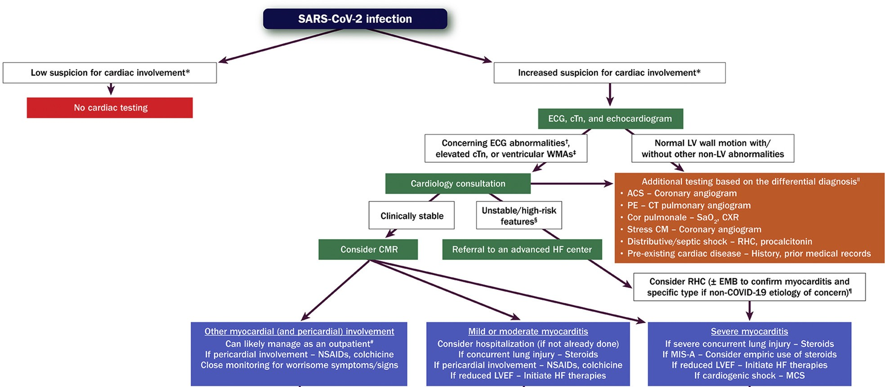
Evaluation and Management of Patients With Suspected Myocarditis or Myocardial Involvement
*Informed by symptoms suggestive of cardiac involvement, including chest pain/pressure, dyspnea, palpitations, and syncope.
†Includes diffuse T-wave inversion, ST-segment elevation without reciprocal ST-segment depression, and prolongation of the QRS complex duration.
‡Often in a noncoronary distribution; may also include abnormal ventricular strain.
§Includes hypotension, cardiogenic shock, sustained ventricular arrhythmias, and/or advanced atrioventricular block.
¶Testing for viral genomes should be performed on frozen heart tissue to exclude other causes of myocarditis, if possible.
#Assumes chest pain is the only symptom, LV systolic function is preserved, and there are no ventricular arrhythmias.
https://doi.org/10.1016/j.jacc.2022.02.003
Notes:
Thus, today we can use these recommendations
Our patient can be considered stable but with progressive heart failure.
Cognizant of 1) the spectrum of myocardial involvement that may be seen with COVID-19; 2) the timing of evaluation relative to SARS-CoV-2 infection; and 3) the range of diagnostic tests available, we can use this multiparametric approach as guide decision-making
Т.о. на сегодняшний день можно придерживаться данных рекомендаций
Нашего пациента можно рассматривать как стабильного, но с прогрессирующей сердечной недостаточностью

Slide 38
TAKE HOME MESSAGE
Correct diagnosis and timely treatment with modern medications can achieve a positive effect even in the most severe patients.
Notes:
From this presentation, we should understand that correct diagnosis and timely treatment with modern medications can achieve a positive effect even in the most severe patients.
Из этой презентации мы должны понять, что correct diagnosis and timely treatment with modern medications can achieve a positive effect even in the most severe patients

Slide 39
Thank you for your attention!

